Slide 1



Hibernate Many-to-Many

Slide 2


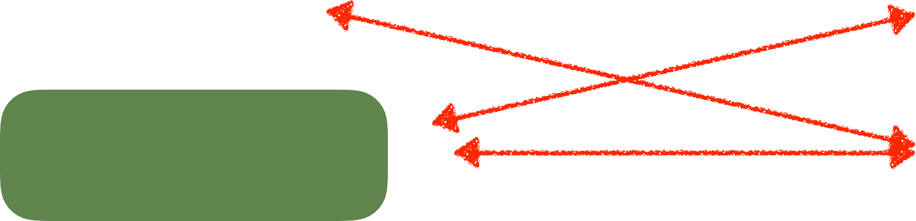
Many-to-Many Mapping
A course can have many students
A student can have many courses
Course
Student
Course
Student
Course
Student
Course
Student
www.luv2code.com

Slide 3





Keep track of relationships
•
Need to track which student is in which course and vice-versa
Course
Student
Course
Student
Join Table
Course
Student
Course
Student
www.luv2code.com

Slide 4

Join Table
A table that provides a mapping between two tables.
It has foreign keys for each table to define the mapping relationship.
www.luv2code.com

Slide 5

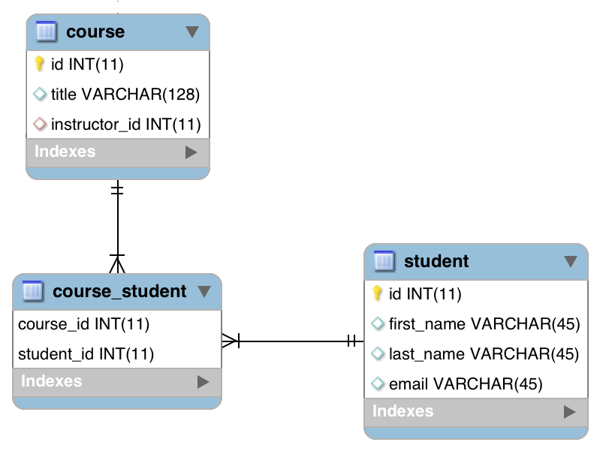

@ManyToMany
Join Table
www.luv2code.com

Slide 6

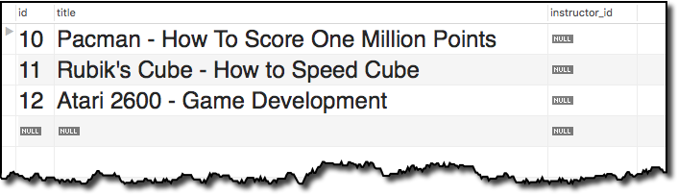

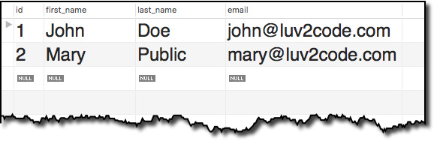
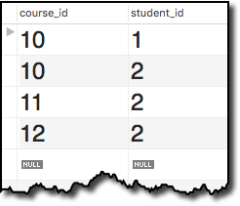

Join Table Example
Find John’s Courses
- Pacman
Join Table
www.luv2code.com

Slide 7


Join Table Example
Find Mary’s Courses
Pacman
Rubik’s Cube
Atari 2600
www.luv2code.com

Slide 8
Development Process: Many-to-Many
Step-By-Step
Prep Work - Define database tables
Update Course class
Update Student class
Create Main App
www.luv2code.com

Slide 9

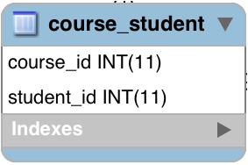

join table: course_student
File: create-db.sql
CREATE TABLE `course_student` (
`course_id` int(11) NOT NULL,
`student_id` int(11) NOT NULL,
PRIMARY KEY (`course_id`, `student_id`),
...
);
www.luv2code.com

Slide 10



join table: course_student - foreign keys
CREATE TABLE `course_student` (
…
CONSTRAINT `FK_COURSE_05`
FOREIGN KEY (`course_id`)
REFERENCES `course` (`id`),
CONSTRAINT `FK_STUDENT`
FOREIGTNabKlEeY (`student_id`_{C}) _{olumn}
REFERENCES `student` (`id`)
…
);
Table
Column
www.luv2code.com

Slide 11

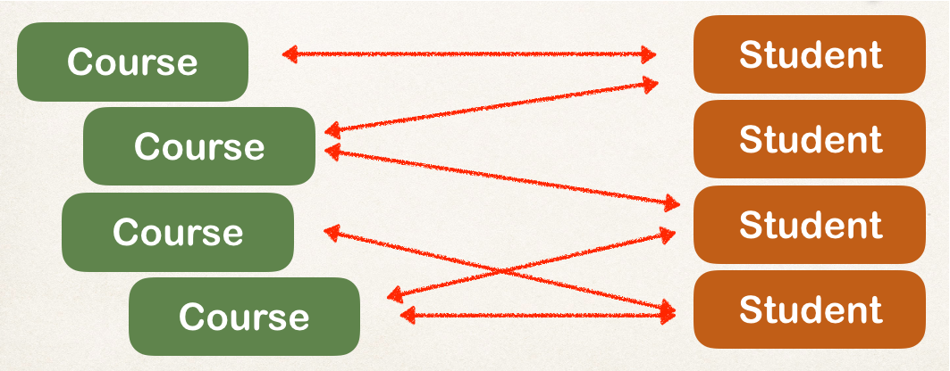

Step 2: Update Course - reference students
@Entity @Table(name="course") public class Course {
…
private List<Student> students;
// getter / setters
…
}
www.luv2code.com

Slide 12






Add @ManyToMany annotation
@Entity @Table(name="course") public class Course {
…
^{Refers to “co}R^{ur}e^{s}fer_s^{id}t”o^{c}“ºs^{l}t^{u}u^{m}de^{n}nt_id” column in “course_st_{i}u_{n}d“e_{c}n_{o}t”_{ur}jo_{se}in_{_s}ta_{tu}b_{d}le_{ent” join table}
@ManyToMany @JoinTable(
name="course_student", joinColumns=@JoinColumn(name="course_id"), inverseJoinColumns=@JoinColumn(name="student_id")
)
private List<Student> students;
// getter / setters
…
}
www.luv2code.com

Slide 13





More: @JoinTable
@JoinTable tells Hibernate
Look at the course_id column in the course_student table
For other side (inverse), look at the student_id column in the course_student table
Use this information to find relationship between course and students
public class Course {
@ManyToMany @JoinTable(
name="course_student", joinColumns=@JoinColumn(name="course_id"), inverseJoinColumns=@JoinColumn(name="student_id")
)
private List<Student> students;
}
www.luv2code.com

Slide 14



More on “inverse”
In this context, we are defining the relationship in the Course class
The Student class is on the “other side” … so it is considered the “inverse”
“Inverse” refers to the “other side” of the relationship
We are here
Inverse / other side
www.luv2code.com

Slide 15

Now, let’s do a similar thing for Student
just going the other way …
www.luv2code.com

Slide 16
Step 3: Update Student - reference courses
@Entity @Table(name="student") public class Student {
…
private List<Course> courses;
// getter / setters
…
}
www.luv2code.com

Slide 17

Add @ManyToMany annotation
@Entity @Table(name="student") public class Student {
…
Refers to “student_id” column
in “cours_{R}e_{e}__{f}s_{e}t_{r}u_{s}d_{t}e_{o}n“t_{c}”_{o}jo_{u}i_{r}n_{se}ta_b_{id}le_{” column}
in “course_student” join table
@ManyToMany @JoinTable(
name="course_student", joinColumns=@JoinColumn(name="student_id"), inverseJoinColumns=@JoinColumn(name="course_id")
)
private List<Course> courses;
// getter / setters
…
}
www.luv2code.com

Slide 18





More: @JoinTable
@JoinTable tells Hibernate
Look at the student_id column in the course_student table
For other side (inverse), look at the course_id column in the course_student table
Use this information to find relationship between student and courses
public class Student {
@ManyToMany @JoinTable(
name="course_student", joinColumns=@JoinColumn(name="student_id"), inverseJoinColumns=@JoinColumn(name="course_id")
)
private List<Course> courses;
}
www.luv2code.com

Slide 19


More on “inverse”
In this context, we are defining the relationship in the Student class
The Course class is on the “other side” … so it is considered the “inverse”
“Inverse” refers to the “other side” of the relationship
Inverse / other side
We are here
www.luv2code.com

Slide 20

Step 4: Create Main App
public static void main(String[] args) {
…
// get the course object
int theId = 10;
Course tempCourse = session.get(Course.class, theId);
// print the course
System.out.println("tempCourse: " + tempCourse);
// print the associated students
System.out.println("students: " + tempCourse.getStudents());
…
}
www.luv2code.com

Slide 21

Real-World Project Requirement
DO NOT
apply cascading deletes!
•
If you delete a course, DO NOT delete the students
Course
Student
Course
Student
Course
Student
Course
Student
www.luv2code.com

Slide 22
Other features
In the next set of videos, we’ll add support for other features
•
Lazy Loading of students and courses
•
Cascading to handle cascading saves … but NOT deletes
If we delete a course, DO NOT delete students
If we delete a student, DO NOT delete courses
www.luv2code.com

